Slide 1

CreditWise Loan System
An End-to-End Machine Learning Pipeline for Automated, Unbiased Loan Approvals

Slide 2

Project Summary
CreditWise is an end-to-end Machine Learning system that predicts whether a loan application should be approved or rejected, based on an applicant's financial and personal profile. It helps financial institutions make faster, more accurate, and data-driven lending decisions — while reducing the risk of default.
The project demonstrates the complete ML lifecycle — from data preprocessing and exploratory analysis to model building, evaluation, and a deployment-ready prediction pipeline.
6
ML Algorithms Compared
End-to-End
Pipeline: Data → Deployment
SHAP-Ready
Explainable Predictions
Scalable
Robust ML Pipeline

Slide 3
Project Objectives
Build a reliable predictive model that determines loan approval status using applicant income, employment status, credit history, loan amount, debt-to-income ratio, and other financial indicators.
Settings
suggest
Automate
Streamline the loan approval workflow end-to-end
Query
stats
Improve Accuracy
Strengthen data-driven decision-making
GPP
good
Minimize Risk
Reduce approval of high-risk applicants
Rocket
launch
Scale
Create a reusable pipeline for real-world use

Slide 4


Executive Summary & Objectives
The Challenge
The Solution
SecureTrust Bank relies on manual verification by loan officers, assessing income, employment, and credit history.
Develop an intelligent, data-driven system powered by Machine Learning to predict approval status prior to human review.
•
Inefficiency: Process is slow and labor-intensive.
•
Automation: Fast-track decision-making processes.
•
Inconsistency: Subject to human bias and errors.
•
Accuracy: Minimize risk with historical data patterns.
•
Business Impact: High-risk applicants approved (losses) or good applicants rejected (lost revenue).
•
Scalability: Deploy a robust, reproducible ML pipeline for real-time predictions.

Slide 5



Dataset Overview & Key Features
The dataset includes demographic, financial, and credit-related attributes critical for assessing lending risk.
Category | Key Features Analyzed | Relevance to Risk
Financial Status | Applicant/Co-applicant Income, Savings, Collateral | Determines repayment capacity and baseline wealth.
Credit History | Credit Score, Existing Loans, DTI (Debt-to-Income) | Highly predictive of default probability and financial strain.
Demographics | Age, Employment Status, Education, Property Area | Contextual indicators that influence stability and long-term earnings.
Target Variable | Approved (1) / Rejected (0) | The dependent variable the model is trained to predict.

Slide 6




Project Workflow
2. Feature Engineering
4. Inference & Deploy
Created new features, imputed missing values, scaled numeric data, and encoded categorical features.
Built a reusable ColumnTransformer pipeline and serialized the final model using Joblib.
1. Data Preparation
3. Model Development
Loaded and inspected the historical dataset, analyzing structures, distributions, and missing values.
Trained multiple baseline and ensemble algorithms, optimizing via Hyperparameter Tuning.

Slide 7









Robust Preprocessing Pipeline
Imputation
Scaling
Encoding
Handled missing values systematically. Used Median Imputation for numeric data (robust to outliers) and Most Frequent for categorical data.
Applied StandardScaler to normalize numerical features, ensuring models like KNN and Logistic Regression converge correctly and quickly.
Utilized OneHotEncoder dropping the first column to prevent multicollinearity, effectively handling categorical variables like Employment Status.

Slide 8
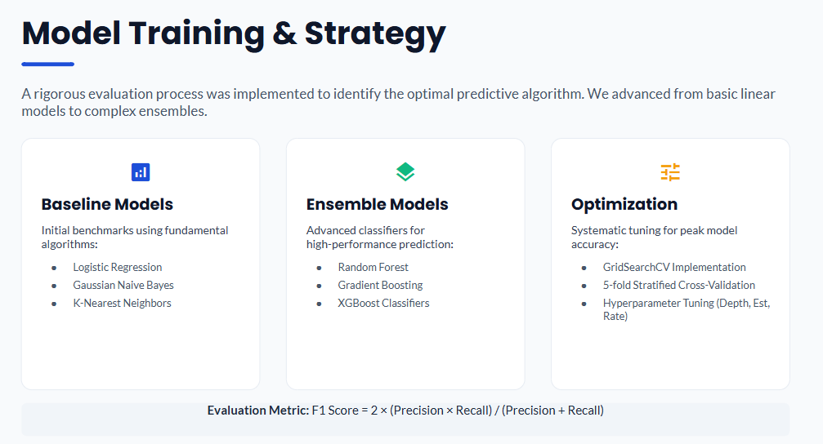

Slide 9

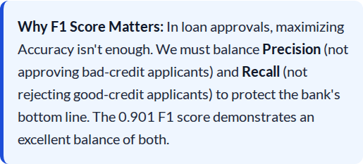
Champion Model: XGBoost
Superior Predictive Power
93.5%
The XGBoost Classifier vastly outperformed baseline models. It successfully captures non-linear relationships and complex interactions between variables.
TEST ACCURACY
0.901
TEST F1 SCORE

Slide 10
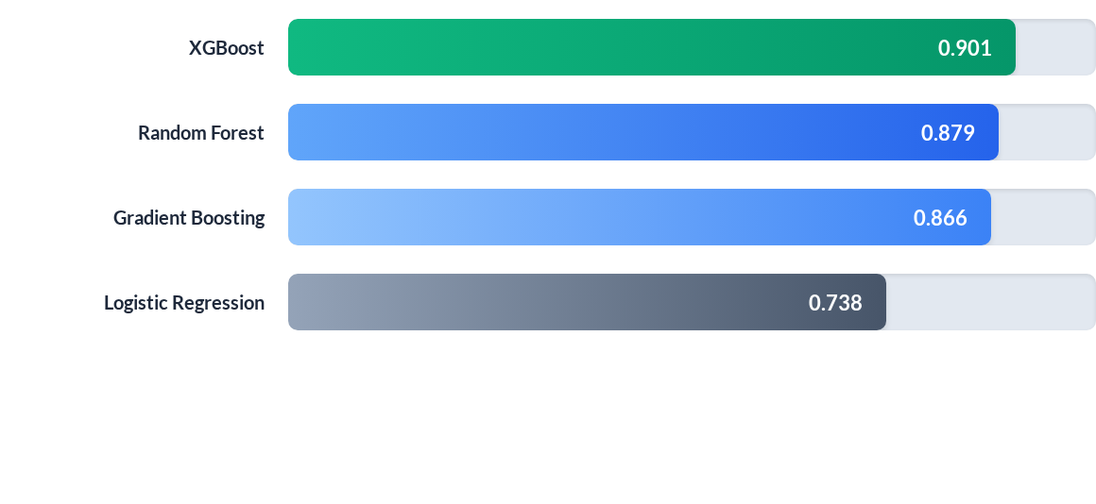
Model Performance Comparison (F1 Score)

Slide 11
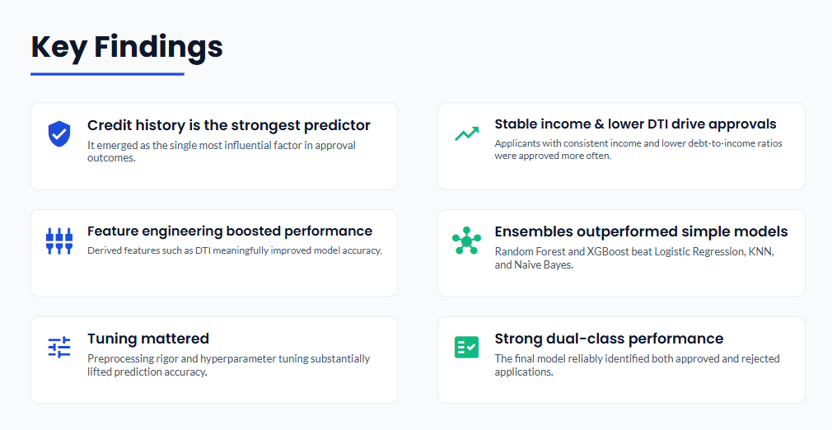

Slide 12
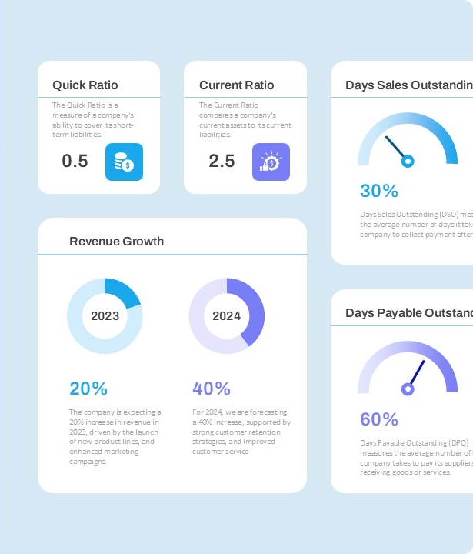
Key Business Findings
The Determinism of DTI & Credit Score
The analysis revealed that Debt-to-Income (DTI) Ratio and Credit Score almost entirely govern approval decisions. Every approved applicant possessed a DTI ratio significantly lower than rejected counterparts.
This explains the dominance of tree-based models (XGBoost, Random Forest), which naturally excel at establishing hard cut-off thresholds for critical features. The model essentially learned the bank's underlying risk policies perfectly.

Slide 13
Skills Demonstrated
Data Analysis
Machine Learning
Tools & Workflow
EDA & Statistical Analysis
Data Cleaning & Preprocessing
Missing Value Treatment
Feature Engineering & Scaling
Categorical Encoding
Classification Algorithms
Model Selection
Hyperparameter Tuning
Cross-Validation
Model Evaluation
Python, Pandas, NumPy
Matplotlib & Seaborn
Scikit-Learn & XGBoost
Joblib Serialization
Jupyter & ML Pipelines

Slide 14
Conclusion
CreditWise delivers a complete machine learning solution for loan approval prediction — spanning preprocessing, feature engineering, model comparison, evaluation, and pipeline deployment.
By comparing multiple algorithms and optimizing performance, the project produces a robust, explainable system that can assist financial institutions in making informed, data-driven lending decisions.
Thank You

